Slide 1
Docker Concepts
1

Slide 2
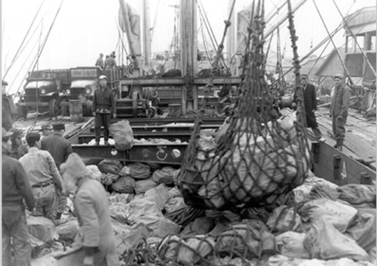
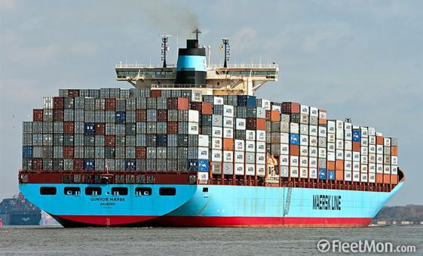
Everybody loves containers

Slide 3
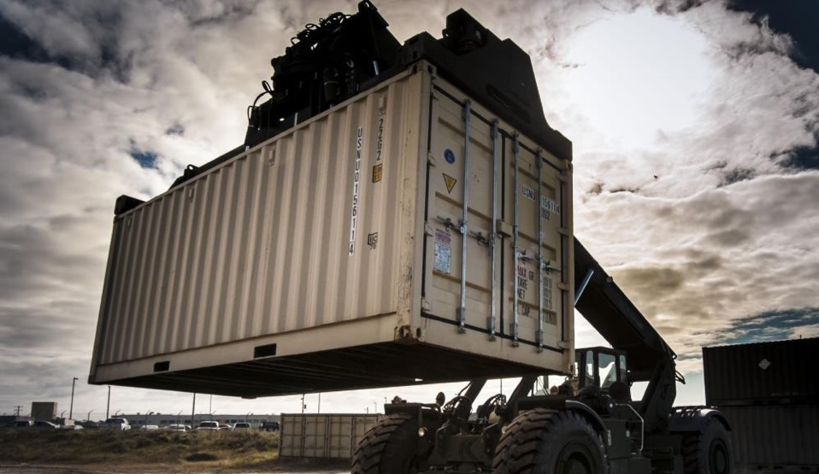
Containers
A standard way to package an application and all its dependencies so that it can be moved between environments and run without changes.
Containers work by isolating the differences between applications inside the container so that everything outside the container can be standardized.
IBM Bluemix Container Service | IBM Confidential | ©2017 IBM Corporation

Slide 4



IBM Bluemix Container Service
Container History Lesson
1982
2000
2005
2006
2007
2008
Today
Unix/chroot
BSD
OpenVZ
Parallels
AIX Wpars
IBM
FreeBSD jails/Solaris zones
Cgroups/Process Containers
IBM/Google
LXC

Slide 5
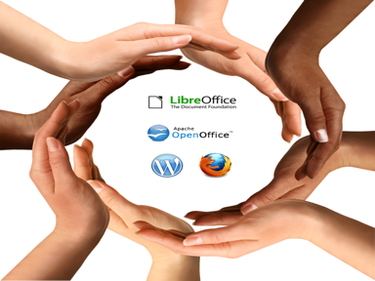

Introduction to Docker
Enabling application development efficiency, making deployment more efficient, eliminating vendor ‘lock-in’ with true portability
Open Software
Launched March 2013
2.0+ billion downloads of Docker images
Open Contribution
2000+ contributors
#2 most popular project
185 community meet-up groups in 58 countries
Open Design
Contributors include IBM, Red Hat, Google, Microsoft, VMware, AWS, Rackspace, and others
Open Governance
12 member governance advisory board selected by the community

Slide 6

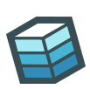

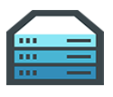













Docker Mission
Docker is an open platform for building distributed applications for developers and system administrators.
Build
Ship
Run
Any App
Anywhere

Slide 7
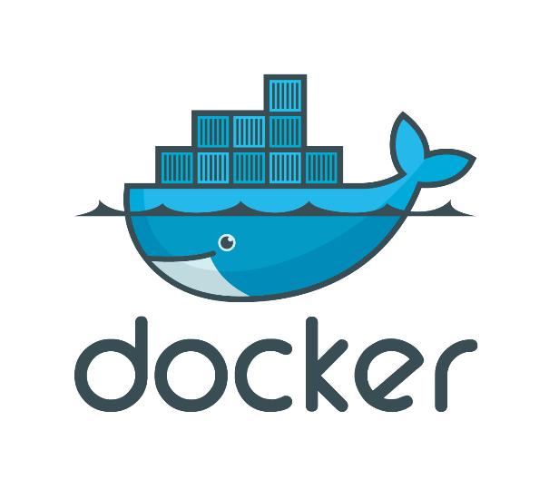

Docker Basics – A Shipping Container for Code
Image
A read-only snapshot of a container stored in Docker Hub to be used as a template for building containers
Container
The standard unit in which the application service resides or transported
Docker Hub/Registry
Available in SaaS or Enterprise to deploy anywhere you choose
Stores, distributes and shares container images
Docker Engine
A program that creates, ships and runs application containers
Runs on any physical and virtual machine or server locally, in private or public cloud
Client communicates with Engine to execute commands
SaaS
Enterprise

Slide 8
Docker Containers A technical view into the shared and layered file systems technology
Docker uses a copy-on-write (union) filesystem
New files(& edits) are only visible to current/above layers
Layers allow for reuse
More containers per host
Faster start-up/download time – base layers are "cached"
Images
Tarball of layers (each layer is a tarball)
CNTR1
CNTR2
CNTR3
CNTR4
Layer
app1
app2
app3
app4
Layer
tomcat
liberty
tomcat
Layer
Fedora
Ubuntu
Base OS / Kernel
Filesystem
Notes:
A container consists of an operating system, user-added files, and meta-data. As we've seen, each container is built from an image. That image tells Docker what the container holds, what process to run when the container is launched, and a variety of other configuration data. The Docker image is read-only. When Docker runs a container from an image, it adds a read-write layer on top of the image (using a union file system as we saw earlier) in which your application can then run.

Slide 9
Why Customers are Interested in Containers
Containers are a critical foundation for distributed apps in Hybrid Clouds
Ship More Software
Accelerate development, CI and CD pipelines by eliminating headaches of setting up environments and dealing with differences between environments. On average, Docker users ship software 7X more frequently¹.
Resource Efficiency
Lightweight containers run on a single machine and share the same OS kernel while images are layered file systems sharing common files to make efficient use of RAM and disk and start instantly.
App Portability
Isolated containers package the application, dependencies and configurations together. These containers can then seamlessly move across environments and infrastructures.
1. Docker internal research of 800 respondents.

Slide 10
Container Orchestration
Layer 6
Development Workflow
Opinionated Containers
OpenShift, Cloud Foundry, Docker Cloud, Deis, Apcera, Apprenda
Layer 5
Orchestration/Scheduling
Service Model
Kubernetes, Docker Swarm, Marathon/Mesos, Nomad, Diego
Layer 4
Container Engine
Docker, rkt, runC (OCI), Osv, LXC, LXD
Layer 3
Operating System
Ubuntu, RHEL, CoreOS, Unikernels
Layer 2
Virtual Infrastructure
vSphere, EC2, GCP, Azure, OpenStack
Layer 1
Physical Infrastructure
Raw Compute, Storage, Network

Slide 11
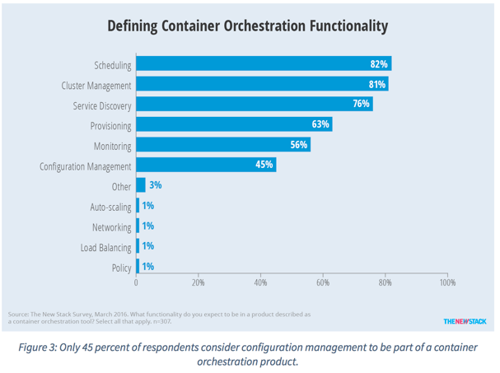
Container Orchestration Responsibilities

Slide 12
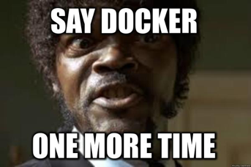


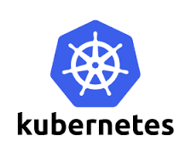




More to Containers than just Docker
Serverless
PaaS
Container Orchestration
Swarm/
Swarm Mode
Container Engine

